Slide 1
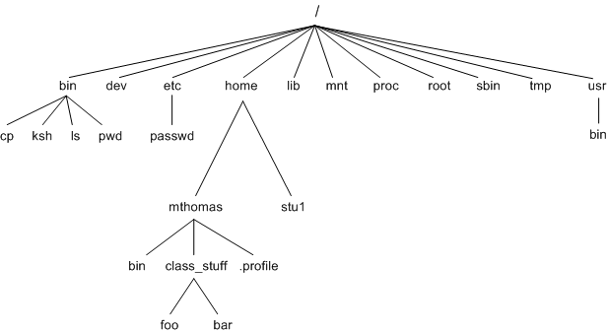
Unix File System

Slide 2
Structure
/bin This is where the executable files are located. These files are available to all users
/dev These are device drivers
/etc Supervisor directory commands, configuration files, disk configuration files, valid user lists, groups, ethernet, hosts, where to send critical messages
/home Contains the home directory for users and other accounts
/lib Contains shared library files and sometimes other kernel-related files
/mnt Used to mount other temporary file systems, such as cdrom and floppy for the CD-ROM drive and floppy diskette drive, respectively

Slide 3
Structure
/proc Contains all processes marked as a file by process number or other information that is dynamic to the system
/boot Contains files for booting the system
/sbin Contains binary (executable) files, usually for system administration. For example, fdisk and ifconfig utilities
/tmp Holds temporary files used between system boots
/usr Used for miscellaneous purposes, and can be used by many users. Includes administrative commands, shared files, library files, and others
/var Typically contains variable-length files such as log and print files and any other type of file that may contain a variable amount of data
/kernel Contains kernel files

Slide 4
Types of Unix files
Ordinary files –
  An ordinary file is a file on the system that contains data, text, or program instructions.
  Used to store your information, such as some text you have written or an image you have drawn. This is the type of file that you usually work with.
  Always located within/under a directory file.
  Do not contain other files.
  In long-format output of ls -l, this type of file is specified by the “-” symbol.

Slide 5
Directories –
  Directories store both special and ordinary files.
  For users familiar with Windows or Mac OS, UNIX directories are equivalent to folders.
  A directory file contains an entry for every file and subdirectory that it houses.
  Each entry has two components.
    The filename
    A unique identification number for the file or directory (called the inode number)
  Branching points in the hierarchical tree.
  Used to organize groups of files.
  May contain ordinary files, special files or other directories.
  Never contain “real” information which you would work with (such as text). Basically, just used for organizing files.
  All files are descendants of the root directory, ( named / ) located at the top of the tree.
  In long-format output of ls –l , this type of file is specified by the “d” symbol.

Slide 6
Special Files –
  Used to represent a real physical device such as a printer, tape drive or terminal, used for Input/Ouput (I/O) operations.
  Device or special files are used for device Input/Output(I/O) on UNIX and Linux systems.
  They appear in a file system just like an ordinary file or a directory.
  On UNIX systems there are two flavors of special files for each device, character special files and block special files :
  When a character special file is used for device Input/Output(I/O), data is transferred one character at a time. This type of access is called raw device access.
  When a block special file is used for device Input/Output(I/O), data is transferred in large fixed-size blocks. This type of access is called block device access.
  For terminal devices, it’s one character at a time. For disk devices though, raw access means reading or writing in whole chunks of data – blocks, which are native to your disk.
  In long-format output of ls -l, character special files are marked by the “c” symbol.
  In long-format output of ls -l, block special files are marked by the “b” symbol.

Slide 7
Pipes –
  UNIX allows you to link commands together using a pipe.
  The pipe acts a temporary file which only exists to hold data from one command until it is read by another.
  A Unix pipe provides a one-way flow of data.
  The output or result of the first command sequence is used as the input to the second command sequence.
  To make a pipe, put a vertical bar (|) on the command line between two commands. For example: who | wc -l
  In long-format output of ls –l , named pipes are marked by the “p” symbol.
Sockets –
  A Unix socket (or Inter-process communication socket) is a special file which allows for advanced inter-process communication.
  A Unix Socket is used in a client-server application framework.
  In essence, it is a stream of data, very similar to network stream (and network sockets), but all the transactions are local to the filesystem.
  In long-format output of ls -l, Unix sockets are marked by “s” symbol.

Slide 8
Hard Link and Symbolic Link??
Before getting into the term Symbolic link and Hard link ,lets understand the term ‘inode’ .
A Unix file is “stored” in two different parts of the disk
  the data blocks - contain the “contents” of the file and
  the inodes – stores the information about the file.
Basically, inode is a file structure on a file system.
More easily, it is a “database” of all file information except the file contents and the file name.
Both the inodes and data blocks are stored in a “filesystem” which is how a disk partition is organized.

Slide 9
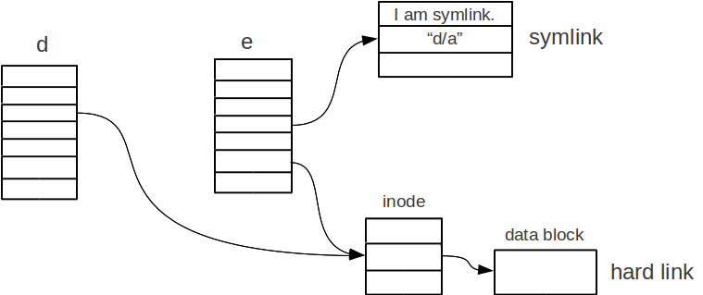
Symbolic link (Symlinks/Soft links) are links between files.
It is nothing but a shortcut of a file(in windows terms).
You can delete the soft links without affecting the actual file or directory it is pointing to.
The reason is because the inode of the linked file is different from that of the inode of the symbolic link.
But if you delete the source file of the symlink ,symlink of that file no longer works or it becomes “dangling link” which points to nonexistent file .
Soft link can span across filesystem.
Soft links can link both files and directories.
A symbolic link shows the character l (file type corresponding to symbolic link) before the permissions for user, group and other users and displays an arrow followed by another file name, meaning it’s a link to another file (see image below).
To create Symlink , ln -s <source> <linkname>

Slide 10
Hard link is the exact replica of the actual file it is pointing to .
Both the hard link and the linked file shares the same inode .
If the source file is deleted ,the hard link still works and you will be able to access the file until the number of hard links to file isn’t 0(zero).
Hard links cannot span across filesystem .
  Why? Hard links are sharing the same inode — they point to the hardware location, instead of directory tree.
  This means that if you were to try to make hard link between ext3 and ext4, then you’d have some problems — these filesystems are different, so they can’t share the inode.
Hard links can link only files,not directories.
  The reason hard-linking directories is not allowed is a little technical.
  Essentially, they break the file system structure.
If the source file of hardline is removed ,the link still works.
  With hard links, there is no concept of original file and links , both files are equal.
Hard links are especially useful in performing “copy on write” applications. They allow you to keep a backup copy of a directory structure, while only using space for the files that change between two versions.
A hard link appears as an ordinary file (meaning you won’t see an l, but a “-” that stands for ordinary file, and no arrow will be displayed)

Slide 11
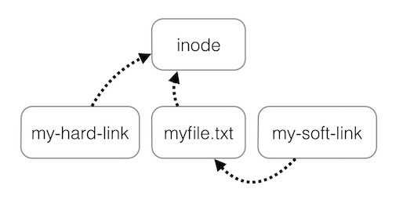
To create Hard link,
  ln <source> <linkname>
So in conclusion, both are pointers to a file.
The difference is the kind of pointer.
  Symlink points to another file by name whereas Hard link points by inode number.

Slide 12
Inode
The ‘inode’ maintains the information about the file/directory such as its owner, access rights, various creation, usage and amendment dates and the addresses used in locating/retrieving various blocks allocated to that file/directory.
Thus, every file, directory or a subdirectory including the root has an inode record of a fixed length.
All inodes are kept together on a disk.
Inodes are numbered as 0, 1, 2, etc. and this number itself is used as a pointer to locate the inode which contains the information about the file/directory.
The inode as well as the Basic File Directory BFD entry does not contain the symbolic file name, though it has been shown in Figure for better comprehension of the correspondence.
The symbolic names are actually stored in a file called Symbolic File Directory (SFD)
For directory, the field “address” is the address of the disk blocks for the file containing the SFD.
However, if the inode is for a file instead of a directory, this “address” field is the address of the disk blocks of the file itself.

Slide 13
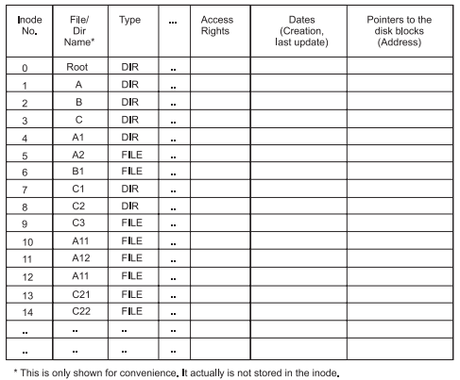
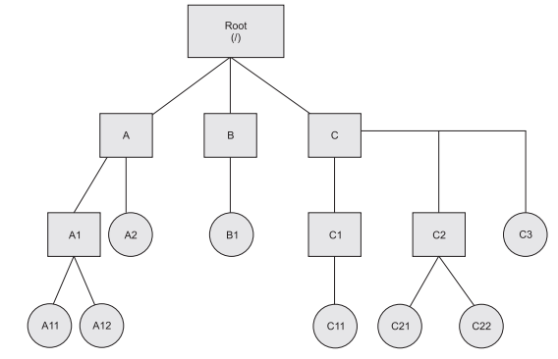

Slide 14
